Slide 1
Sinusoids and Phasors
Chapter 9

Slide 2

Introduction
A sinusoid is a signal that has the form of the sine or cosine function.
A sinusoidal current is usually referred to as alternating current (ac). Such a current reverses at regular time intervals and has alternately positive and negative values. Circuits driven by sinusoidal current or voltage sources are called ac circuits.
A sinusoidal forcing function produces both a transient response and a steady-state response, much like the step function. The transient response dies out with time so that only the steady-state response remains. When the transient response has become negligibly small compared with the steady-state response, we say that the circuit is operating at sinusoidal steady state. It is this sinusoidal steady-state response

Slide 3
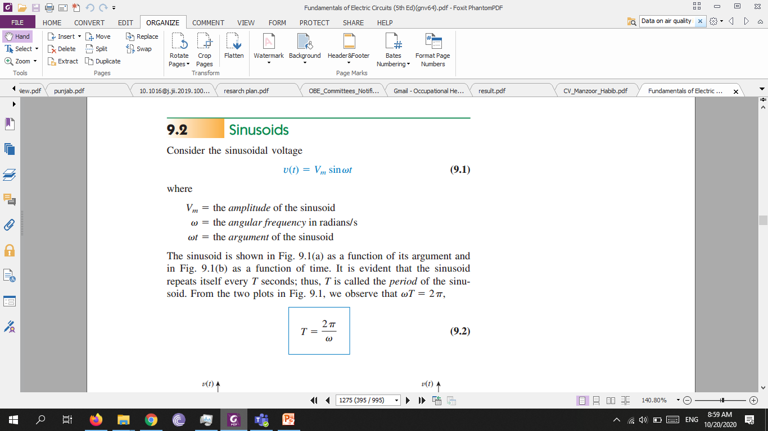
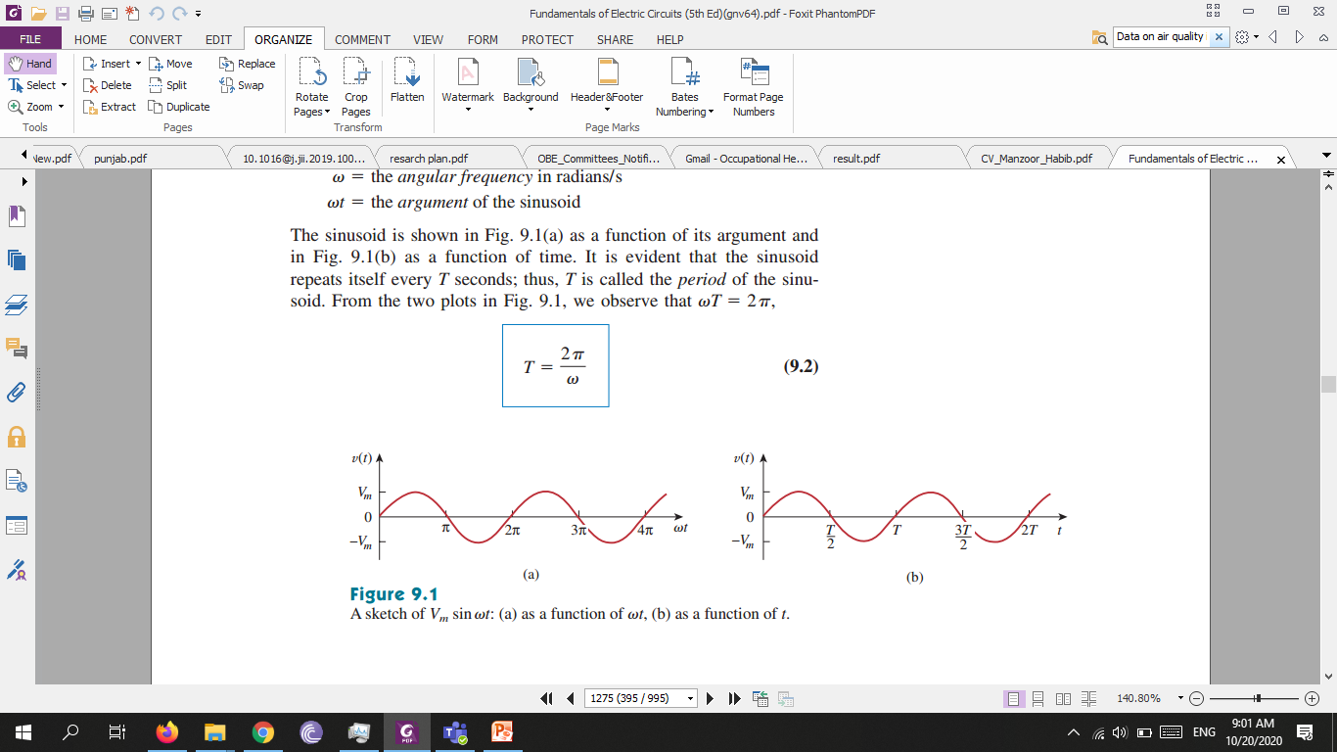
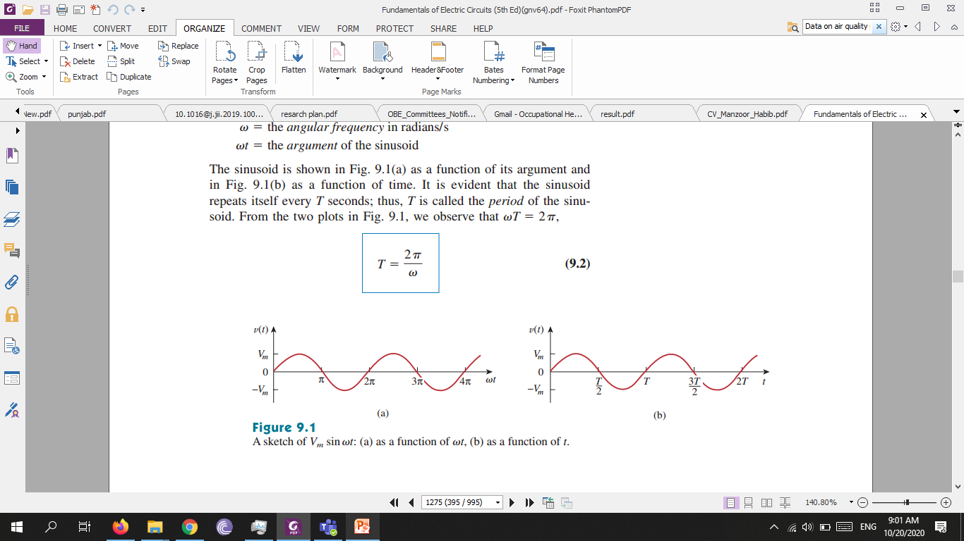
Sinusoids
Consider the sinusoidal voltage

Slide 4
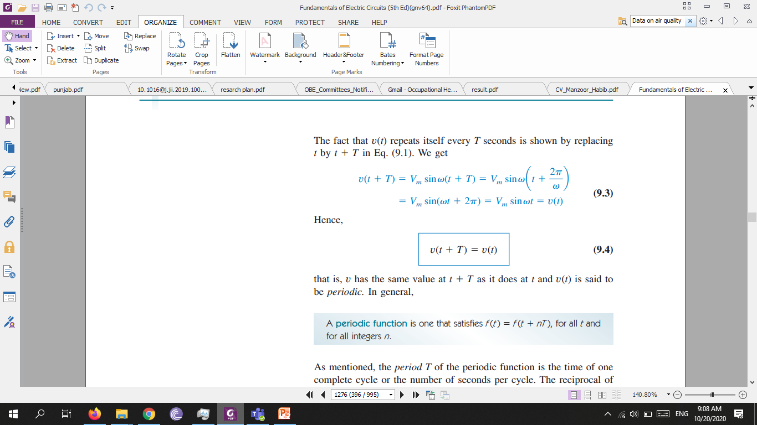
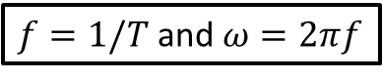
A periodic function is one that satisfies f(t)= f(t+nT), for all t and for all integers n.
As mentioned, the period T of the periodic function is the time of one complete cycle or the number of seconds per cycle. The reciprocal of this quantity is the number of cycles per second, known as the cyclic frequency f of the sinusoid. Thus,
$f=1/T$ and $ω=2πf$
While $ω$ is in radians per second (rad/s), $f$ is in hertz (Hz).

Slide 5
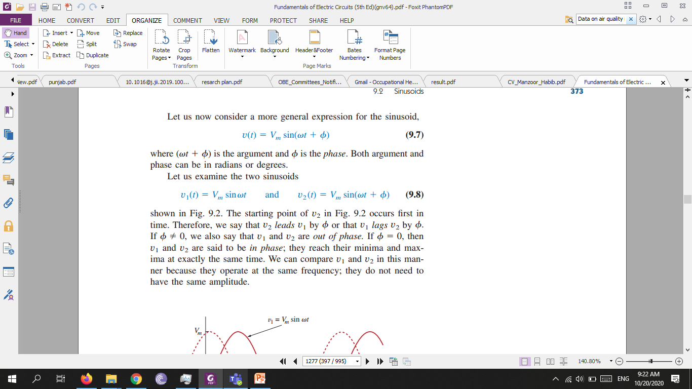
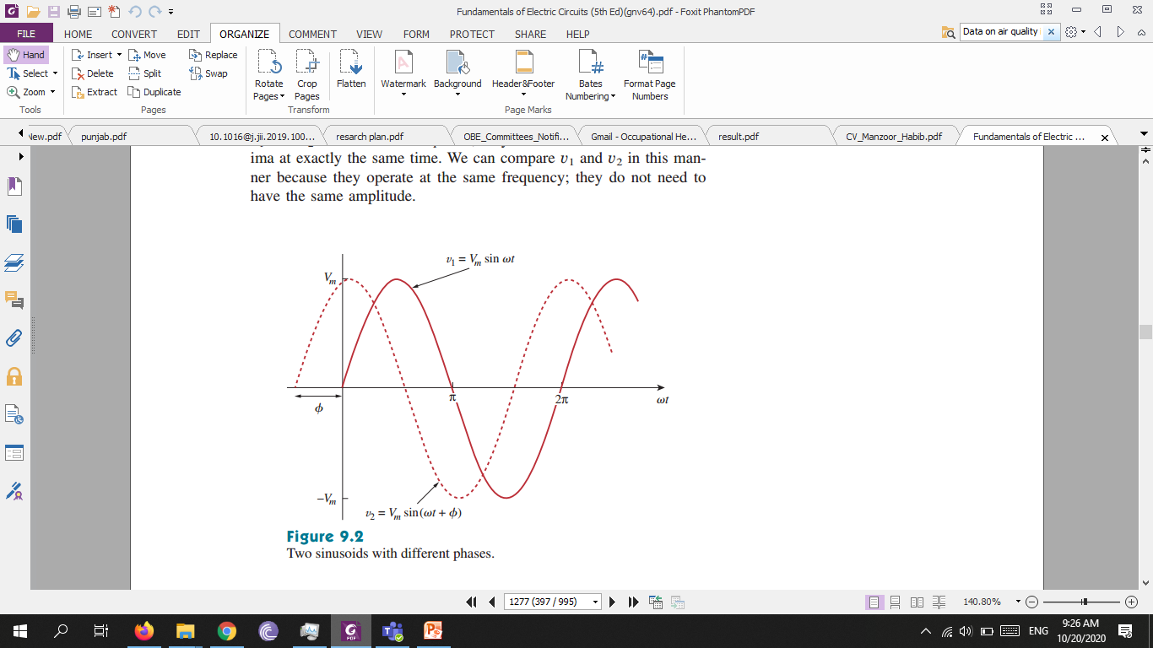

Slide 6
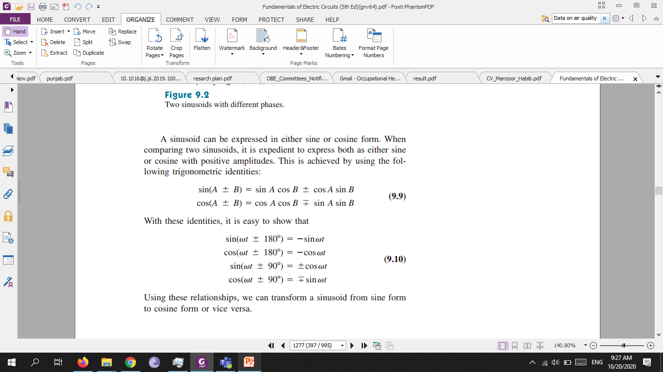
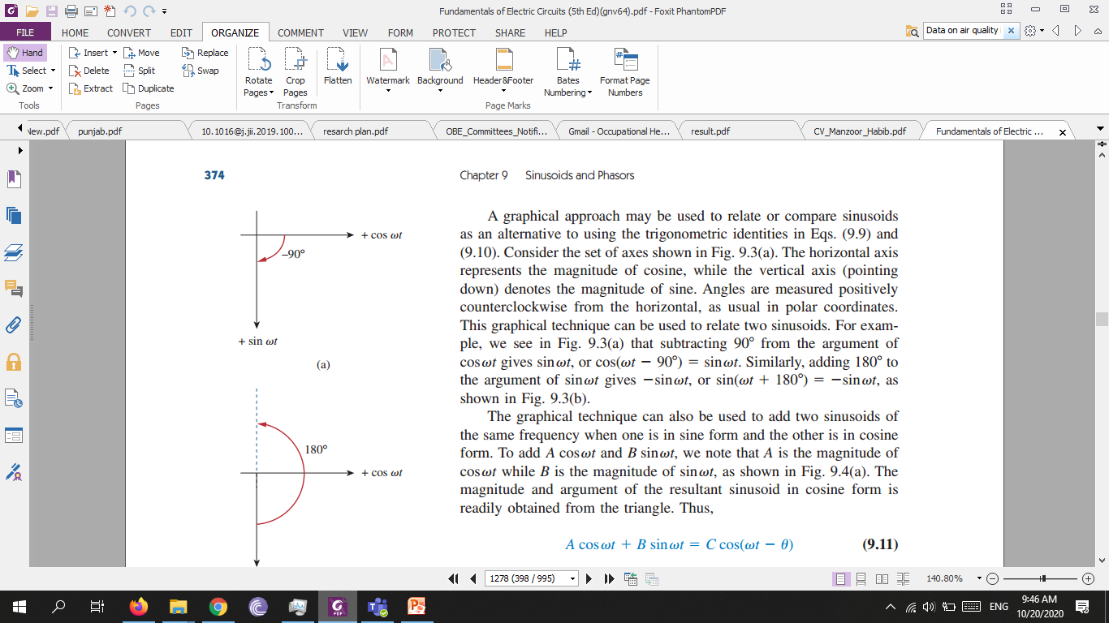

Slide 7
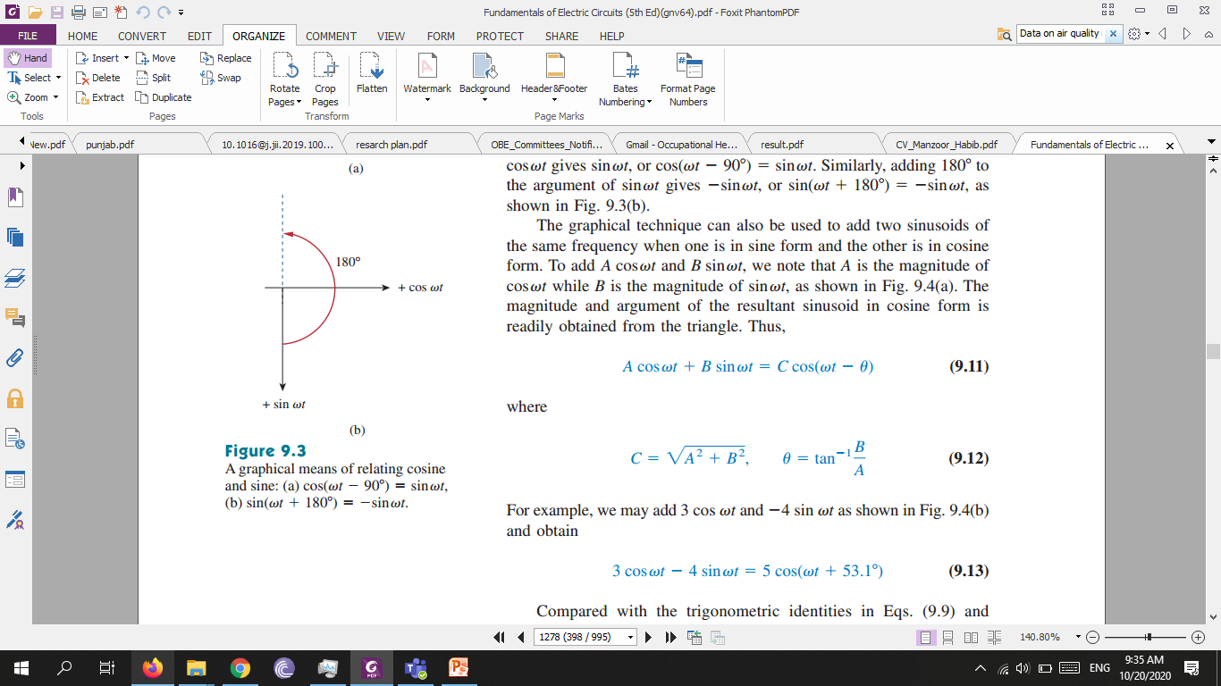
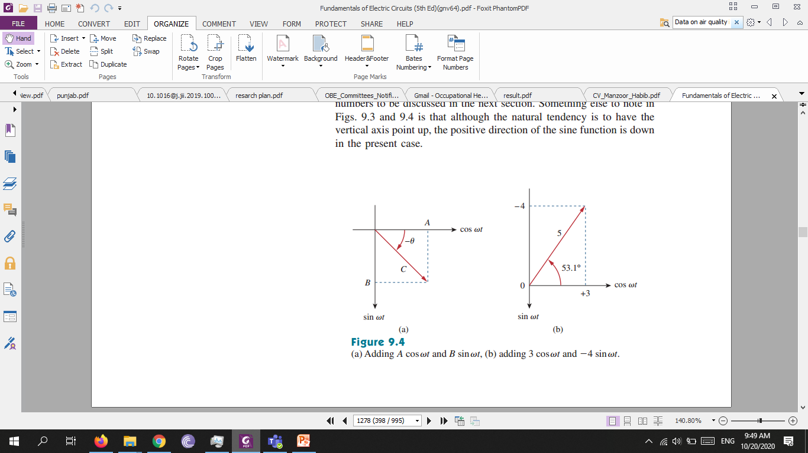

Slide 8
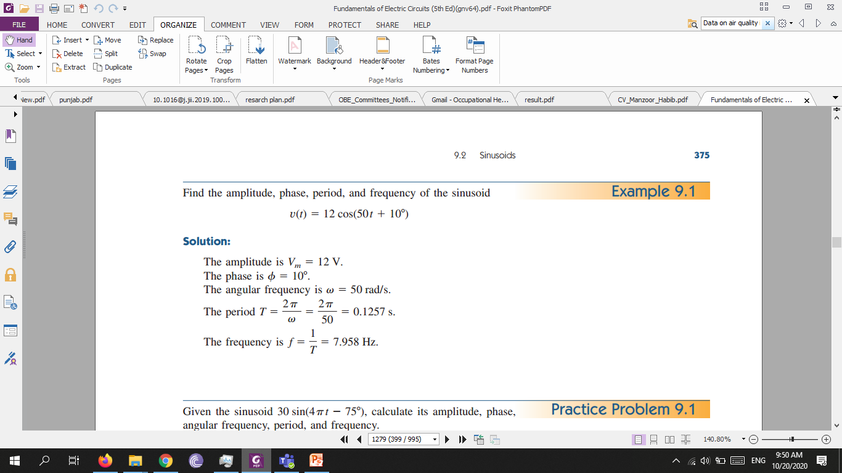
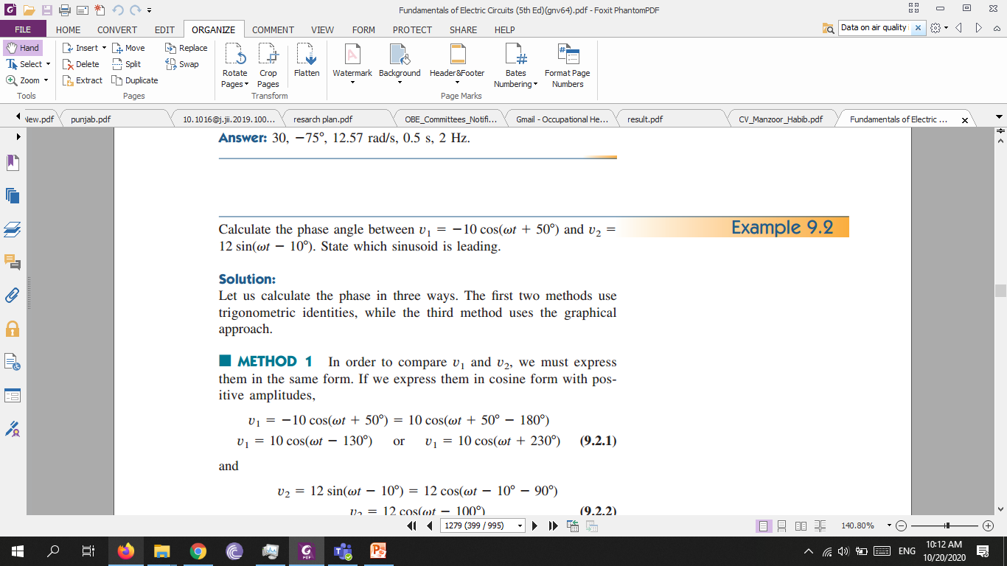
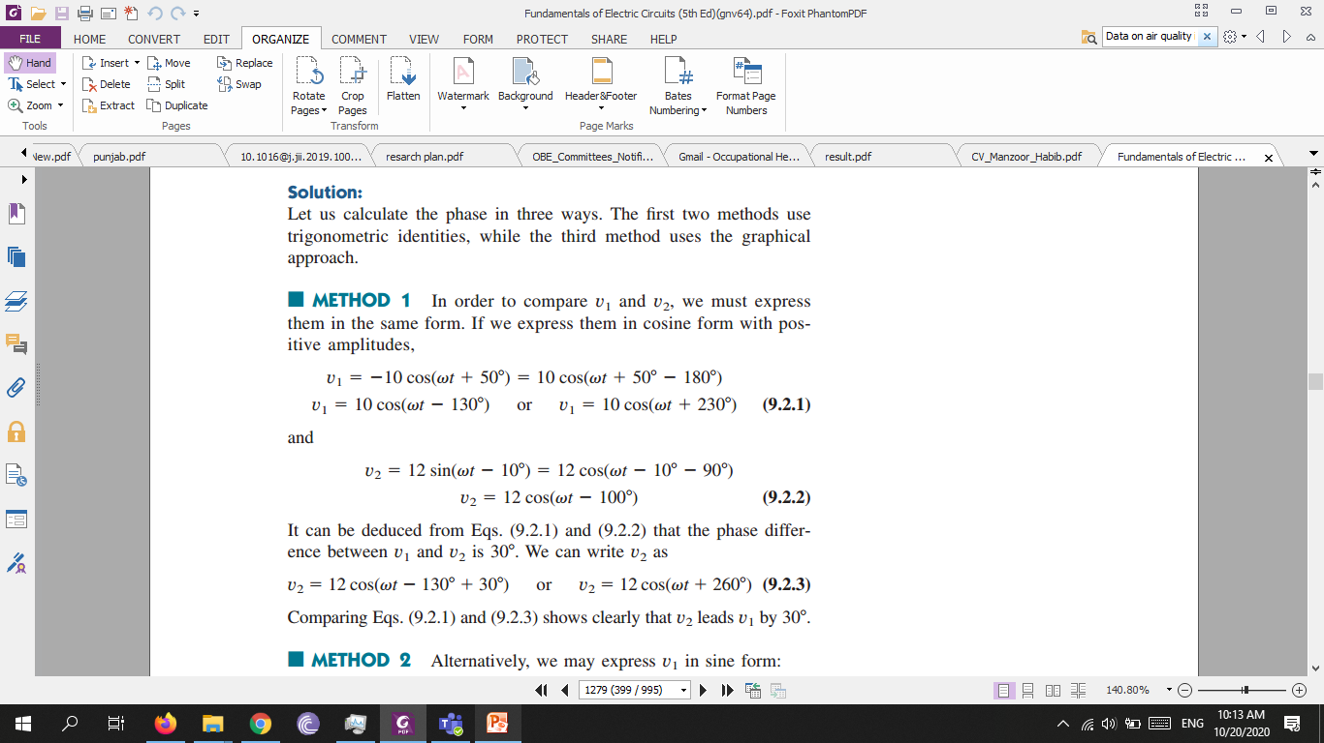

Slide 9
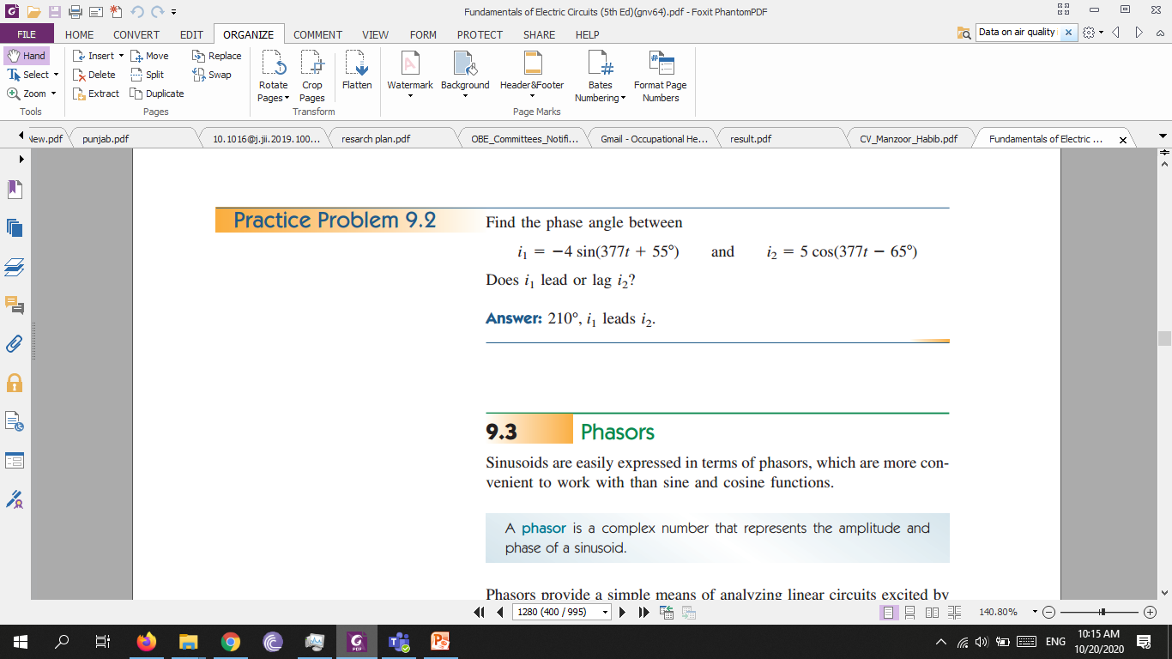

Slide 10
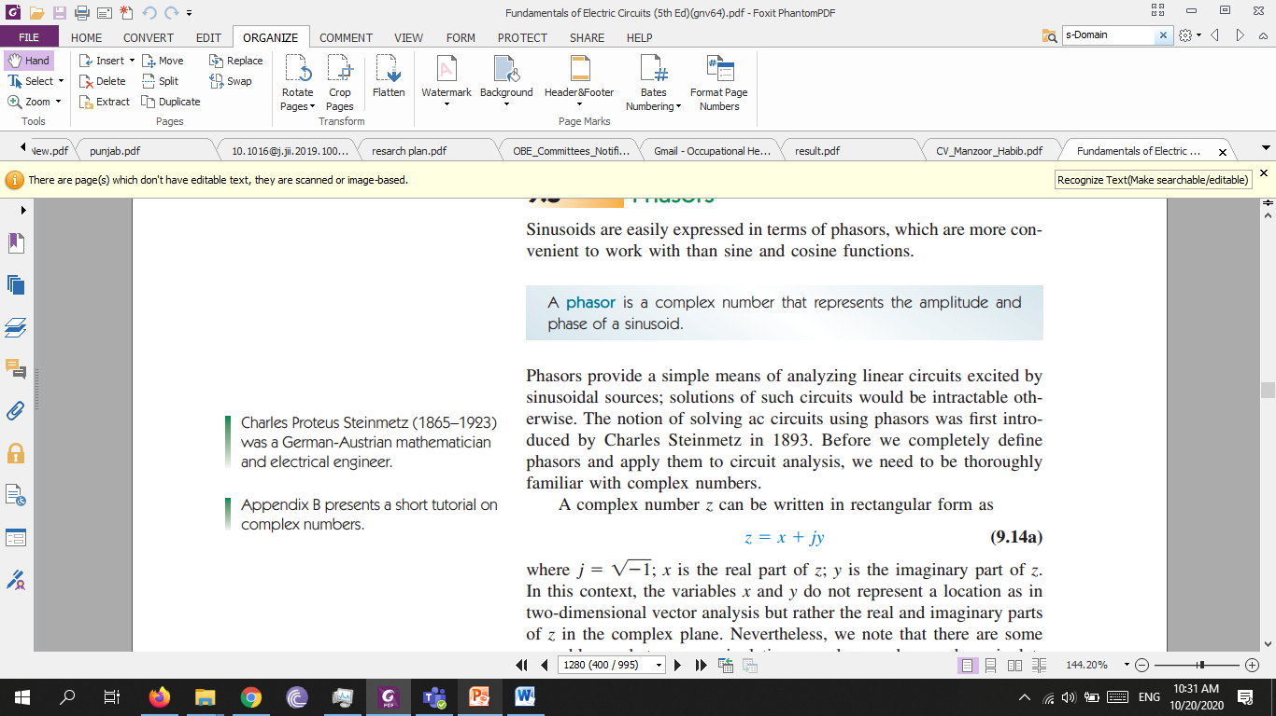
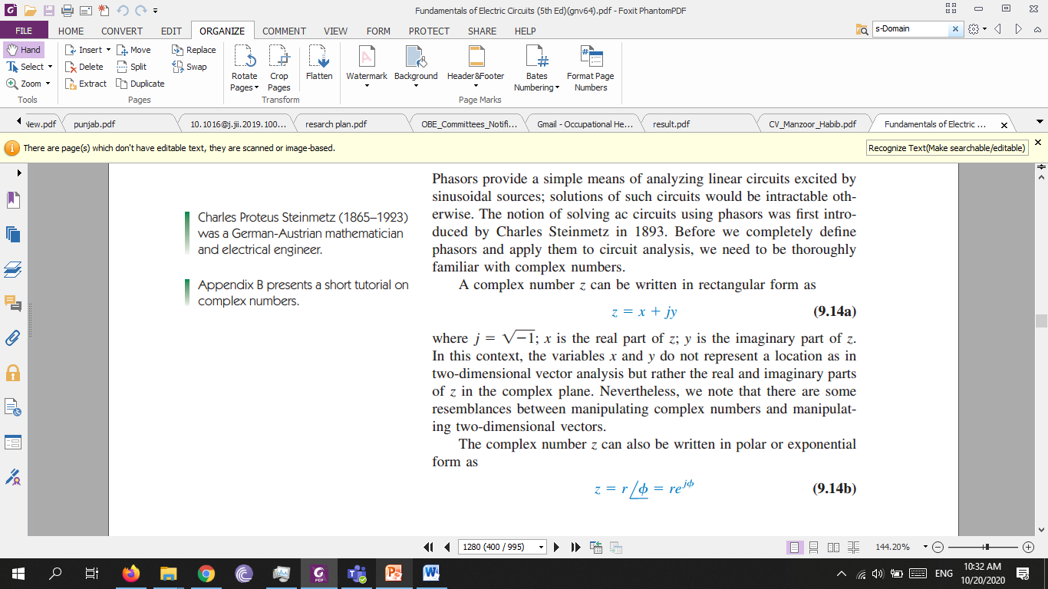
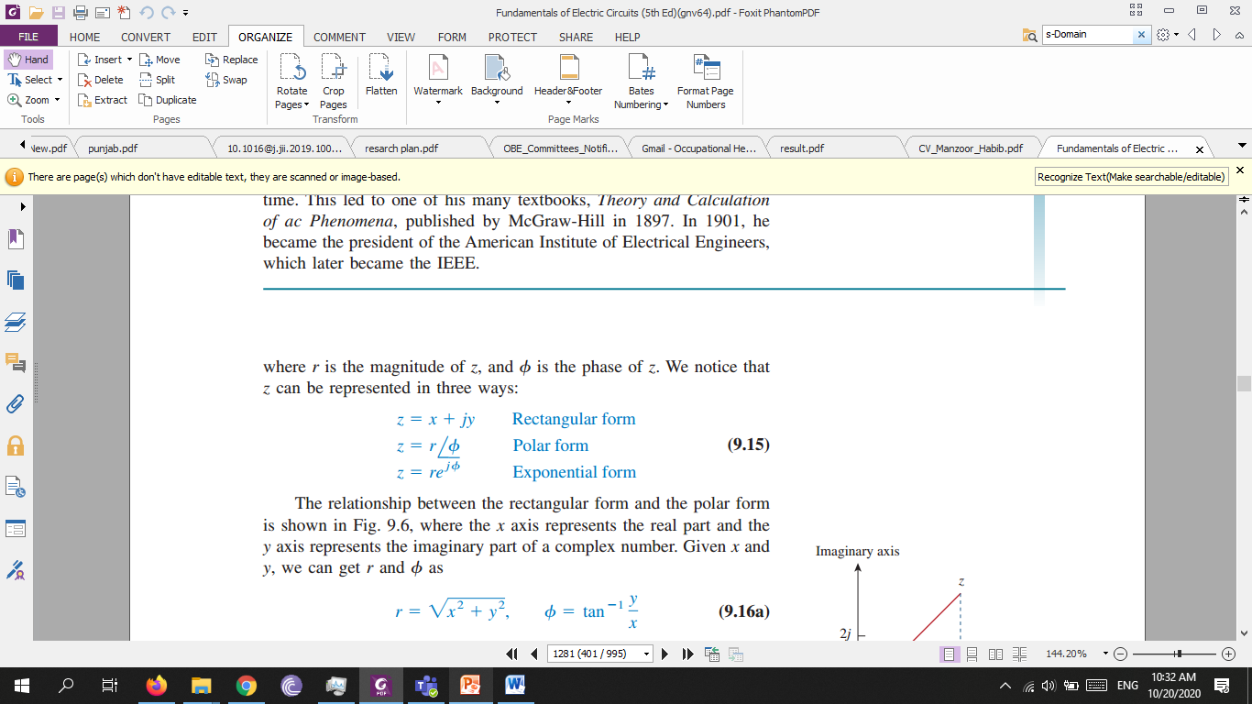
Phasors
A phasor is a complex number that represents the amplitude and phase of a sinusoid.

Slide 11
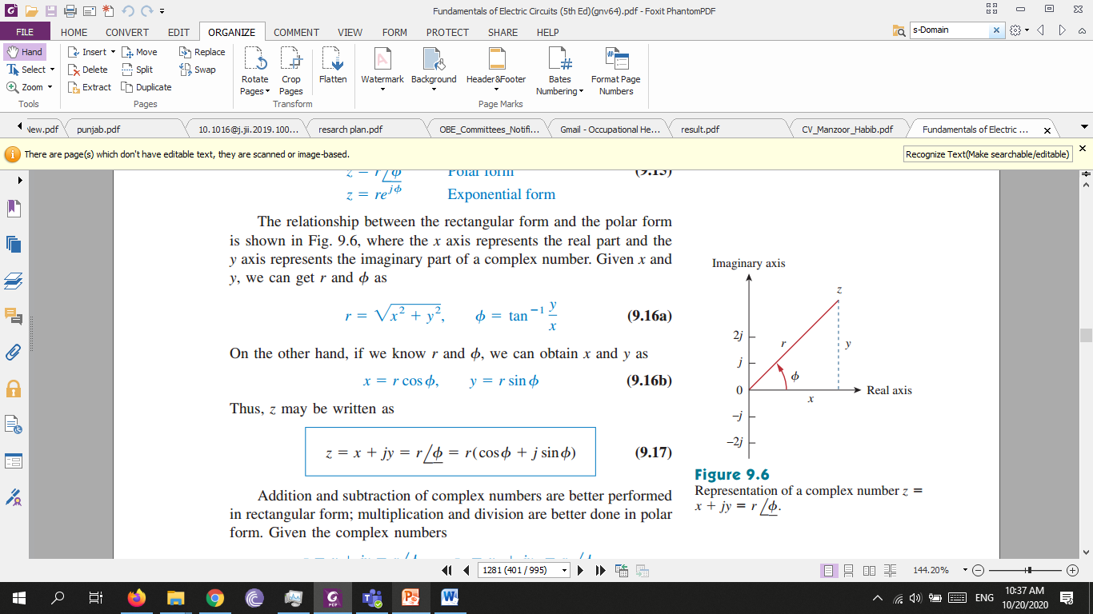
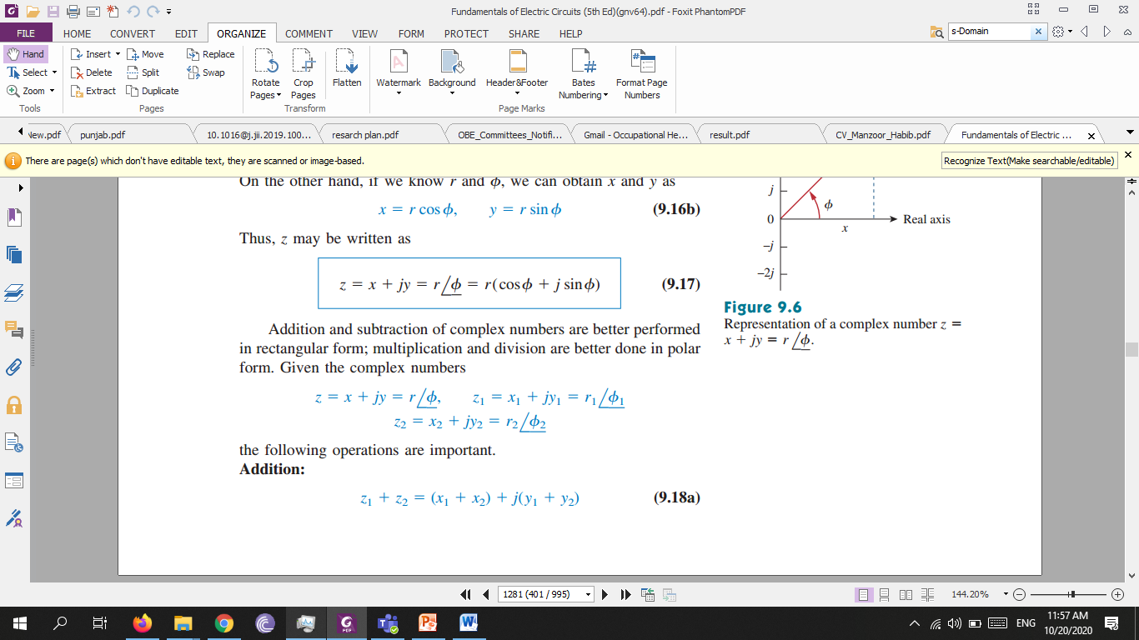
Addition and subtraction of complex numbers are better performed in rectangular form; multiplication and division are better done in polar form. Given the complex numbers.

Slide 12
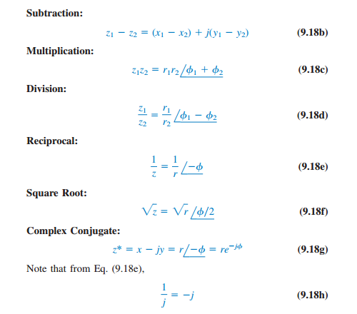

Slide 13
